Slide 1


November 19, 2021, 9 AM - 5 PM EST - ONLINE

Slide 2




Sponsors

Slide 3
Room 1
Friday, November 19, 2021
Ben Steinhauser
Cloud Solution Architect
Azure Static Web Apps: I am a Believer!
Alpa Buddhabhatti
Cluster reply , London , UK
Azure Logic Apps for everyone
Maxim Salnikov
Developer Engagement Lead at Microsoft, Tech Communities Lead, Keynote Speaker
Azure cloud for the web frontend developers
Rajaniesh Kaushikk
Enterprise Cloud Solution Architect
Deploying SQL server Always on Availability Group on Azure Kubernetes Services (AKS).
Thomas Hafermalz
Azure Solution Architect@Trivadis AG
Introduction to Azure Kubernetes Service (AKS)
Sergey Chubarov
Ethical Hacker
Offensive Azure Security
Taiob Ali
Microsoft MVP -Data Platform
Options and considerations for migrating SQL Server databases to Azure
Sam Cogan
Solutions Architect & Azure MVP
Regain Control with Azure Governance
Marco Obinu
Azure MVP, Advisory Engineer @ Softjam S.p.A, Geek to the bone
Train your Bicep to improve your ARM's strength!

Slide 4
Room 2
Friday, November 19, 2021
Deepthi Goguri
SQL Database Administrator
Azure Fundamentals 101
Ron Dagdag
Lead Software Engineer at Spacee and Microsoft MVP
AI to the edge with Azure Percept
Eric Cheng
Digital Solutions Architect -Komatsu Australia
Monitoring your Canvas Power Apps with Azure Application Insights
Asif Waquar
Cloud Solution Architect at ABN AMRO Bank
Automate app deployment with Terraform & Azure DevOps
Abhijeet Jadhav
Microsoft MVP -Office 365 Development
Azure Communication Services -What, Where and How to use
Debasis Saha
Microsoft Certified Trainer, C# Corner MVP, Lead Engineer @ WeFiveSoft Pvt. Ltd., Author, Blogger, Speaker
Azure Functions -Zero to Hero
Shruti Kuber
Developer Advocate
Cellular Network Diagnostics with Azure IoT
Shweta Lodha
C# Corner MVP, Speaker, Blogger, Data Analyst and Developer
Finding Abnormalities in Data using Azure Cognitive Services

Slide 5
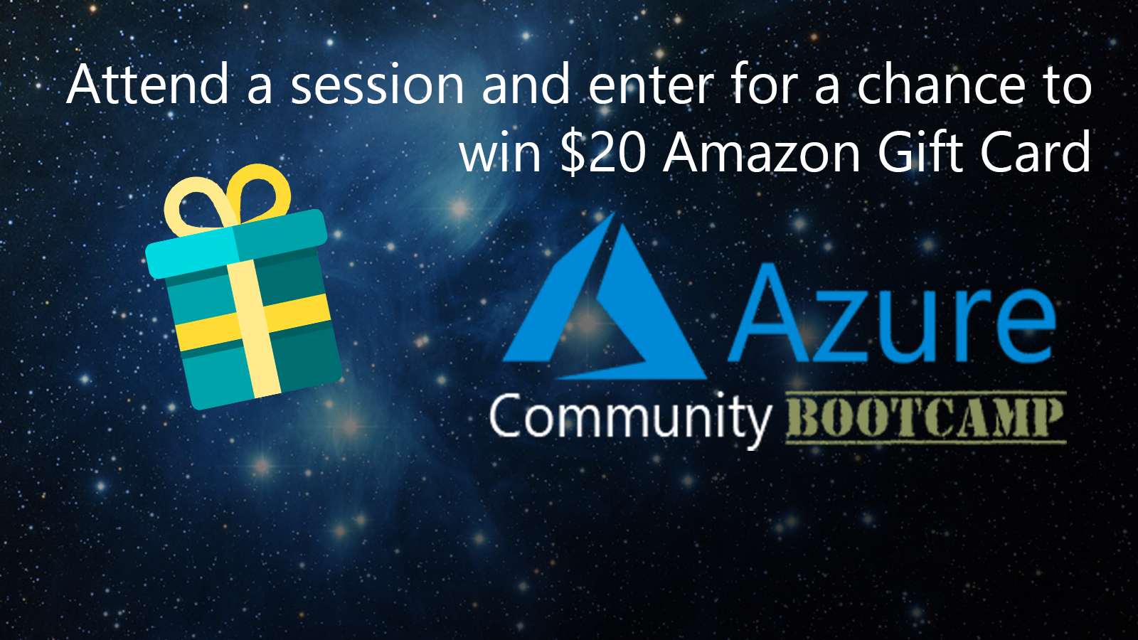
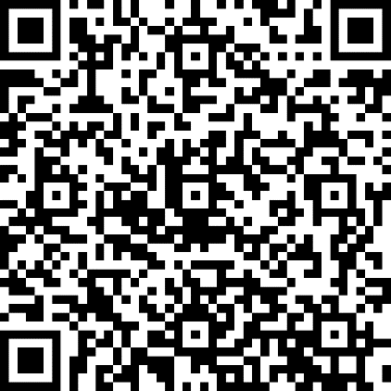
ENTER
SPEAKER
CODE
XXXXXX
We'll be giving away 1 gift card per session.
Session Feedback / Raffle Entry
https://bit.ly/acbc2021

Slide 6












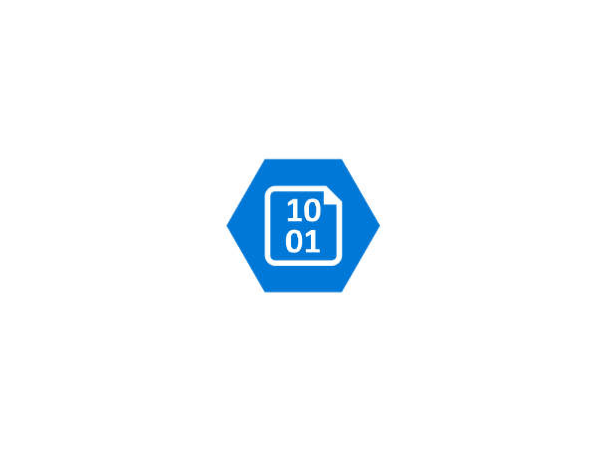













Regain Control

Slide 7





About Me
Sam Cogan
Solution Architect – Willis Towers Watson
Microsoft Azure MVP
samcogan.com
@samcogan
sam-cogan

Slide 8



Regain Control
Cost
Security
Compliance

Slide 9
Regain Control
Review
Organise
Audit
Enforce

Slide 10




Review
How much are we spending?
What resources are we spending it on?
Where are we out of compliance
Where should we focus our effort?

Slide 11



Review
Resource Graph
Cost Management
Security Centre

Slide 12



Organise
Create a subscription hierarchy
Classify Subscriptions and Resources
Apply access rights consistently

Slide 13



Organise
Management Groups
Tags
RBAC
Notes:
Demo management group setup
Apply RBAC to management groups
Tag application

Slide 14
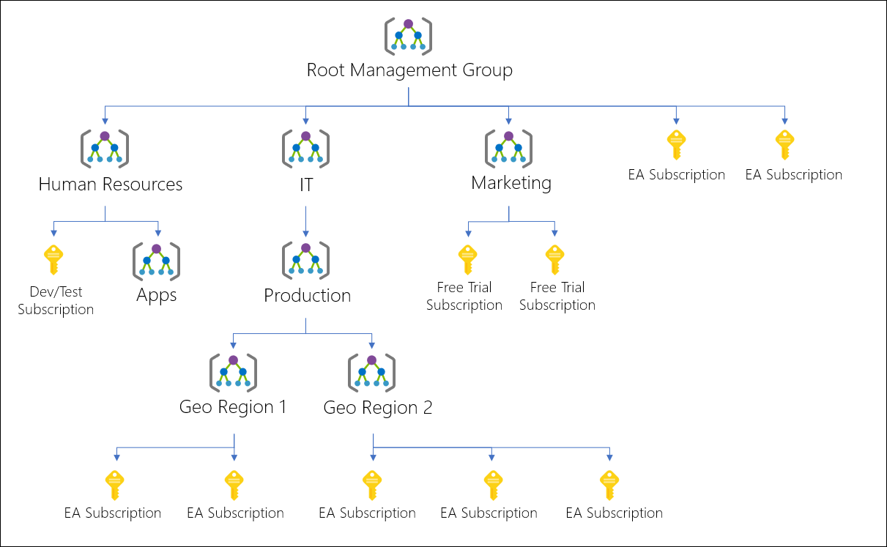
Management Groups

Slide 15

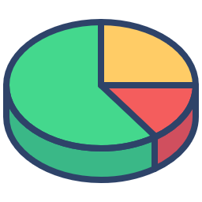

Audit
Develop Policies
Apply Budgets
Audit the impact of these policies
Get ready for enforcement
Notes:
Policy creation, show code
Policy Type:
Deny: generates an event in the activity log and fails the request
Audit: generates a warning event in activity log but doesn't fail the request
Append: adds the defined set of fields to the request
AuditIfNotExists: enables auditing if a resource doesn't exist
DeployIfNotExists: deploys a resource if it doesn't already exist
Disabled: doesn't evaluate resources for compliance to the policy rule
Language - https://docs.microsoft.com/en-us/azure/governance/policy/concepts/definition-structure#policy-rule
Initiatives

Slide 16

Audit
Cost Management
Azure Policy

Slide 17


Enforce
Change policies to enforcement
Add resolution actions
Enforce Budgets
Create new subscriptions already compliant

Slide 18

Enforce
Azure Policy
Cost Management
Azure Blueprints

Slide 19
Regain Control
Review: Cost Management Resource Graph Security Centre
Organise: Management Groups Tags Roles
Audit: Policies Budgets
Enforce: Policies Blueprints Budgets

Slide 20


Review
Understand what you are spending & why
Know that only approved resources are deployed
Know that you are adhering to security best practice
Further improvement!

Slide 21
About Me
Sam Cogan
Solution Architect – Willis Towers Watson
Microsoft Azure MVP
samcogan.com
@samcogan
sam-cogan

